Slide 1

Automata
languages
lexers, parsers, interpreters

Slide 2
Introduction ANTLR

Slide 3
ANTLR
ANTLR (ANother Tool for Language Recognition)
is a powerful parser generator for reading, processing, executing, or translating structured text or binary files.
It's widely used to build languages, tools, and frameworks.
From a grammar, ANTLR generates a parser that can build parse trees and also generates a listener interface (or visitor) that makes it easy to respond to the recognition of phrases of interest.

Slide 4
ANTLR
ANTLR is really two things:
a tool that translates your grammar to a parser/lexer in Java (or other target language) and
the runtime needed by the generated parsers/lexers.
https://www.antlr.org/index.html

Slide 5
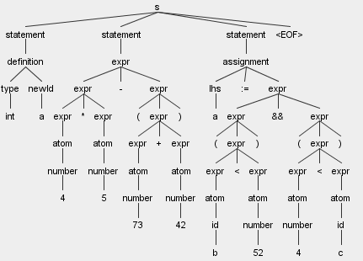
data flow
text
application (Java)
Antlr
lexer
TOKEN
reg.expr.
stream of TOKENs
parser
grammar rules
parse tree
tree walker
your Java methods
actions!

Slide 6
DEMO

